Slide 1
Leveraging Data for Sales Optimization: Customer and Product Analysis
Analyzing Revenue Distribution Across Product Categories: Insights from SQL Data

Slide 2
Objective:
This project aims to analyze sales data to uncover key insights into customer behavior, product popularity, and overall sales performance.
By examining trends and patterns in customer purchases and product sales, the project seeks to identify areas for potential growth and optimization.
The analysis will guide data-driven decision-making to enhance business strategies and improve revenue outcomes.

Slide 3
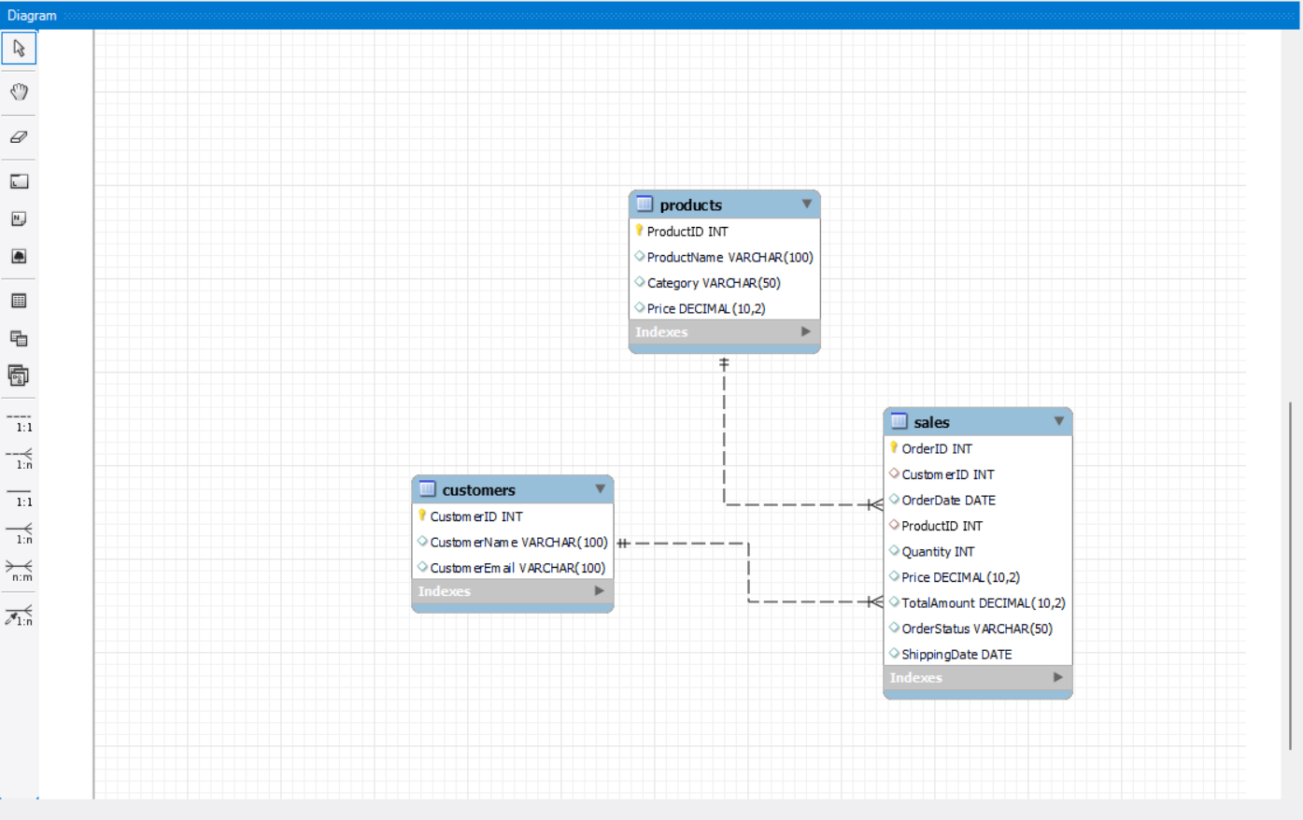
Entity relationship diagram

Slide 4
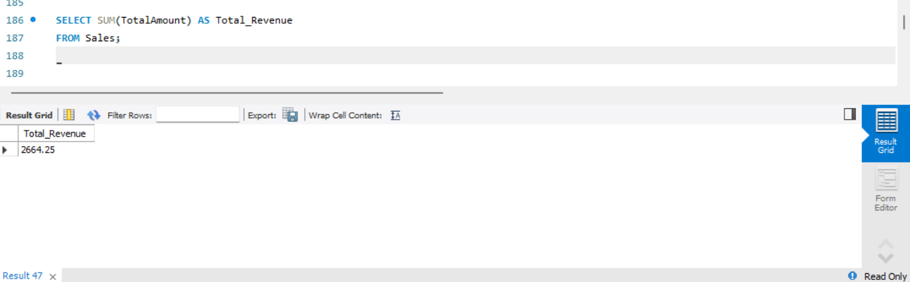
1. What is the total revenue generated from all sales

Slide 5
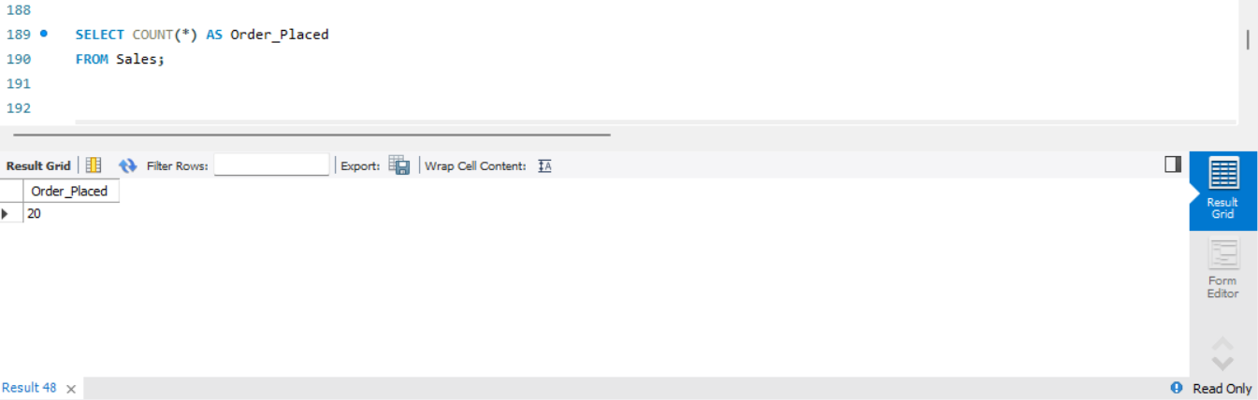
2. How many orders have been placed in total

Slide 6
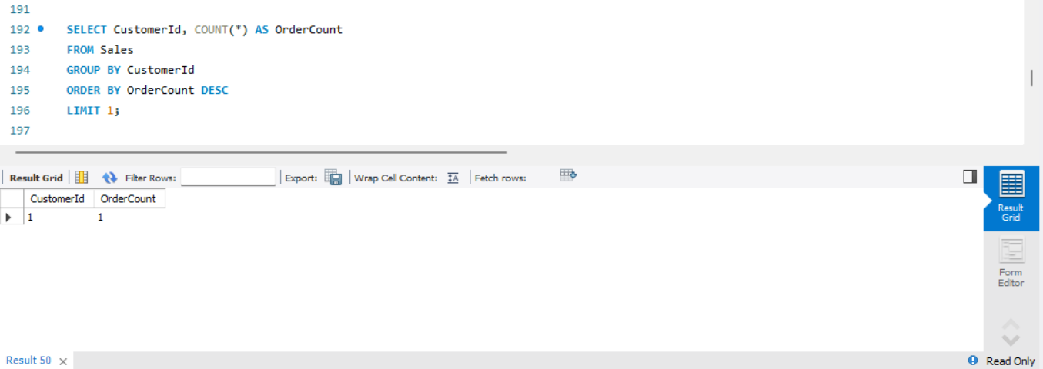
3. Which customer has placed the highest number of orders

Slide 7
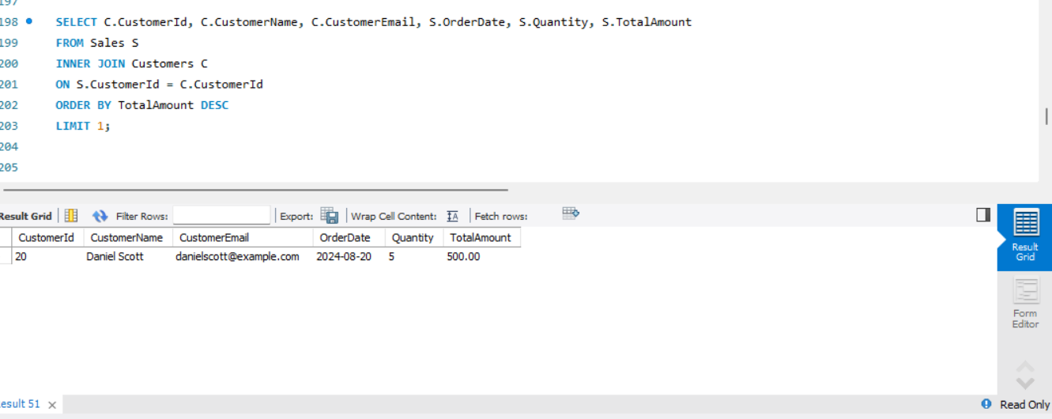
4. Which customer has spent the most money

Slide 8
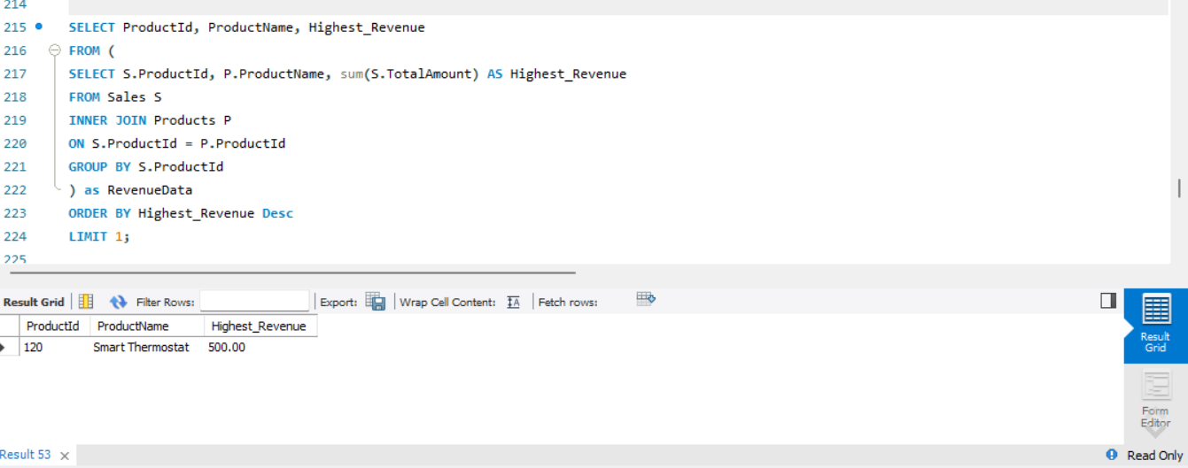
5. Which product has been sold the most in terms of quantity

Slide 9
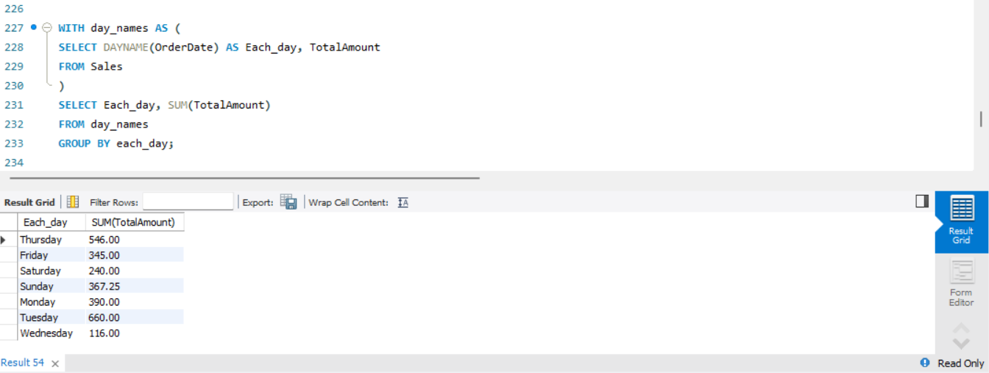
6. What were the total sales for each day

Slide 10
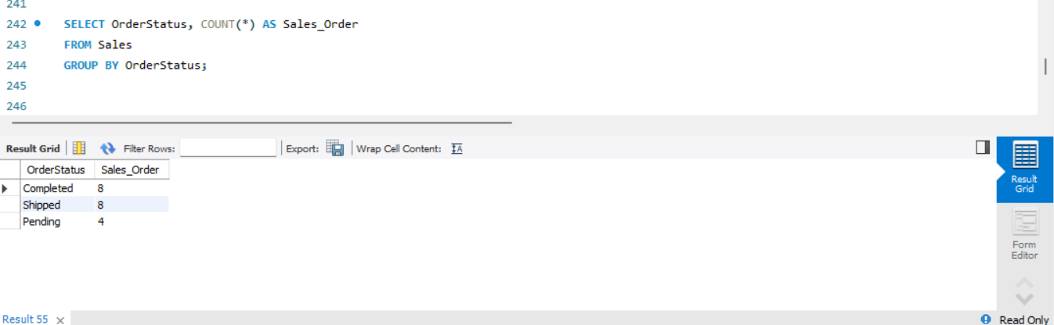
7. How many orders are there for each order status

Slide 11
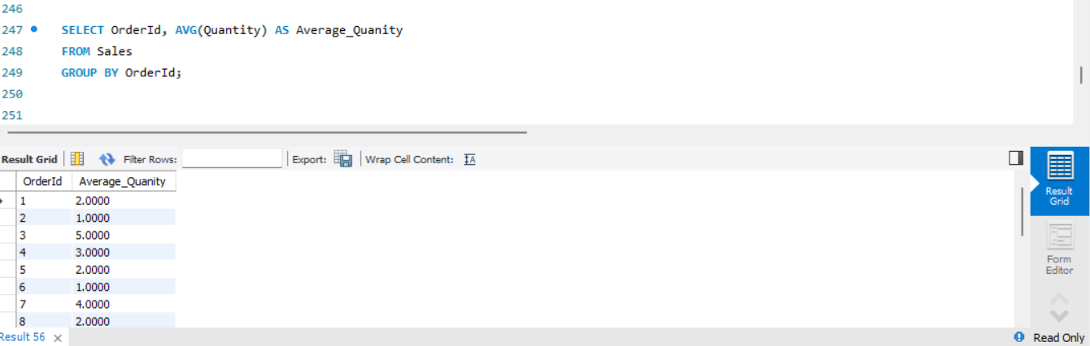
8. What is the average quantity of products sold per order

Slide 12
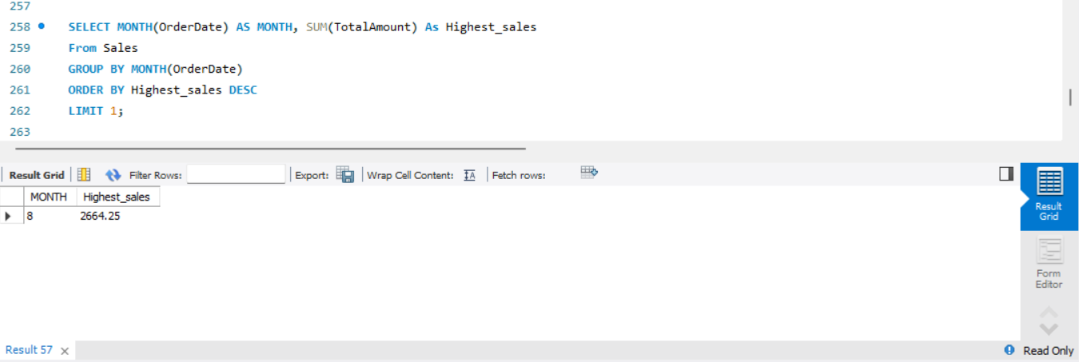
9. Which month had the highest total sales revenue

Slide 13
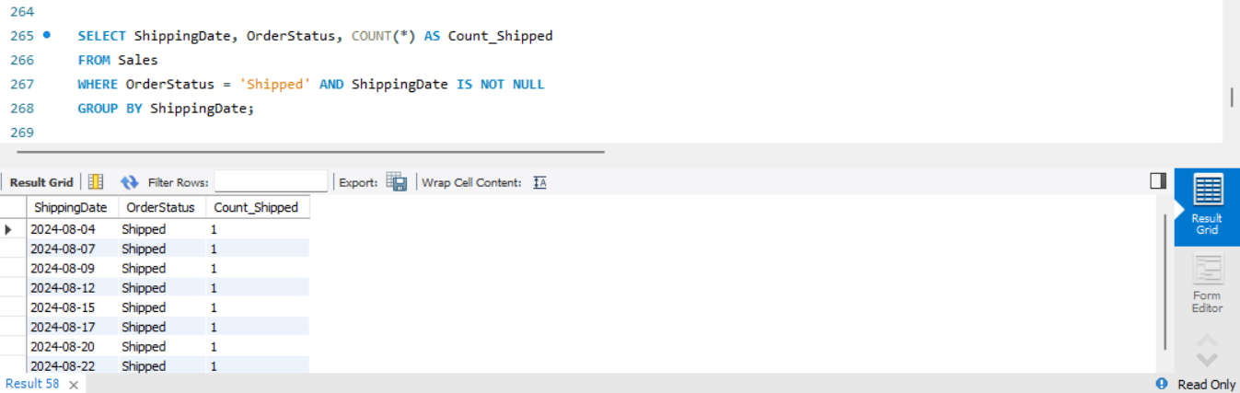
10. How many orders were shipped on each shipping date

Slide 14
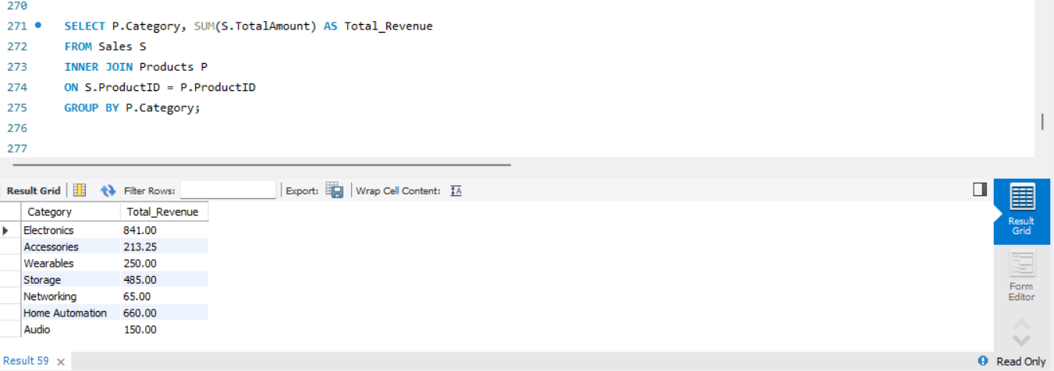
11. What is the total revenue generated for each product category

Slide 15
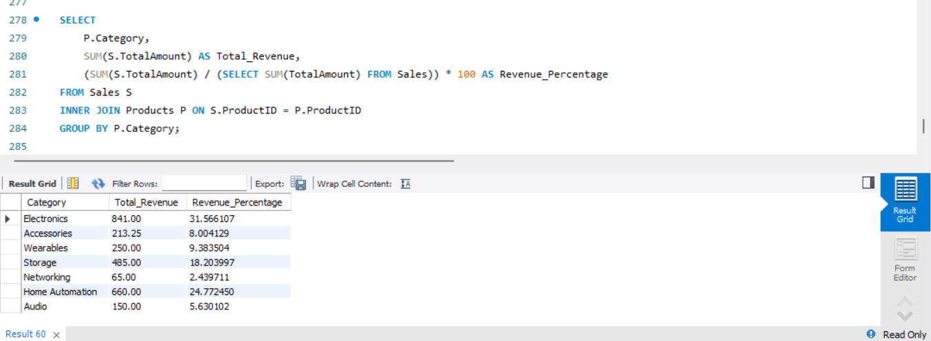
12. What is the revenue distribution across different product categories

Slide 16
Insights
Category Revenue Distribution:
The total revenue is concentrated in a few key product categories, with the top categories contributing a significant portion of the overall sales. This indicates which product lines are the most profitable.
Sales Performance by Day:
The data reveals patterns in sales performance across different days of the week, showing peak sales on specific days, which could inform targeted marketing and promotional strategies.
Customer Purchase Behavior:
Analysis of customer order data shows that a small percentage of customers account for a large share of revenue, suggesting the importance of focusing on high-value customers for retention and personalized offers.

